Slide 1
Introduction to Databases CT042-3-1-IDB (version1)
Week 6: Entity Relationship Model
(Part 1)

Slide 2
Topic & Structure of The Lesson
Components of ER model
Types of attributes
Connectivity and Cardinality

Slide 3
Learning Outcomes
At the end of this topic, You should be able to
Explain the main characteristics of entity relationship components
Explain how relationships between entities are defined and refined and how those relationships are incorporated into the database design process
Describe how ERD components affect database design and implementation

Slide 4
Key Terms You Must Be Able To Use
If you have mastered this topic, you should be able to use the following terms correctly in your assignments and exams:
Weak Entity
Derive Attribute
Domain
Single value & Multi value attribute
Composite primary key

Slide 5
In this chapter, you will learn:
The main characteristics of entity relationship components
How relationships between entities are defined and refined and how those relationships are incorporated into the database design process
How ERD components affect database design and implementation

Slide 6
The Entity Relationship (ER) Model
ER model forms the basis of an ER diagram
ERD represents conceptual database as viewed by end user
ERDs depict database’s main components:
Entities
Attributes
Relationships

Slide 7
Entities
Refers to entity set and not to single entity occurrence
Corresponds to table and not to row in relational environment
In both Chen and Crow’s Foot models, entity is represented by rectangle containing entity’s name
Entity name, a noun, is usually written in capital letters

Slide 8
Attributes
Characteristics of entities
In Chen model, attributes are represented by ovals and are connected to entity rectangle with a line
Each oval contains the name of attribute it represents
In Crow’s Foot model, attributes are written in attribute box below entity rectangle

Slide 9
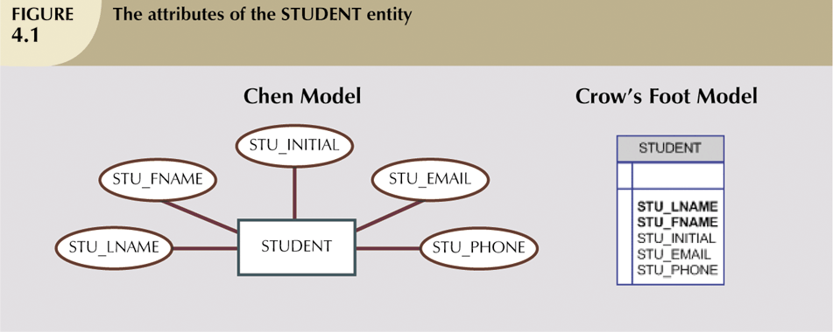
Attributes (continued)

Slide 10
Domains
Attributes have domain
Domain is attribute’s set of possible values
Attributes may share a domain

Slide 11
Identifiers (Primary Keys)
Underlined in the ERD

Slide 12
Composite Primary Keys
Primary keys ideally composed of only single attribute
Possible to use a composite key
Primary key composed of more than one attribute

Slide 13
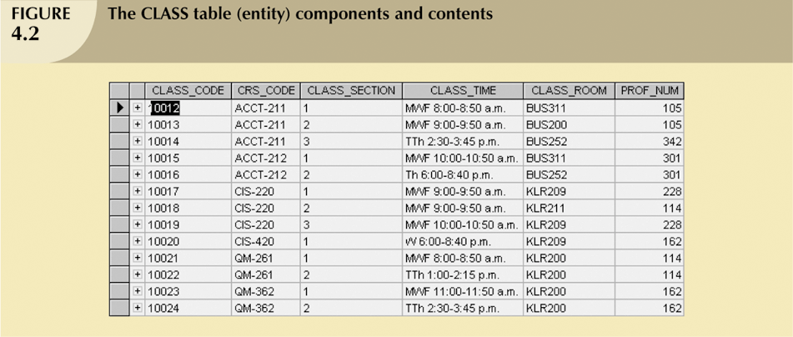
Composite Primary Keys (continued)

Slide 14
Composite and Simple Attributes
Composite attribute can be subdivided
Simple attribute cannot be subdivided

Slide 15
Single-Valued Attributes
Single-value attribute can have only a single value

Slide 16
Multivalued Attributes
Multivalued attributes can have many values

Slide 17
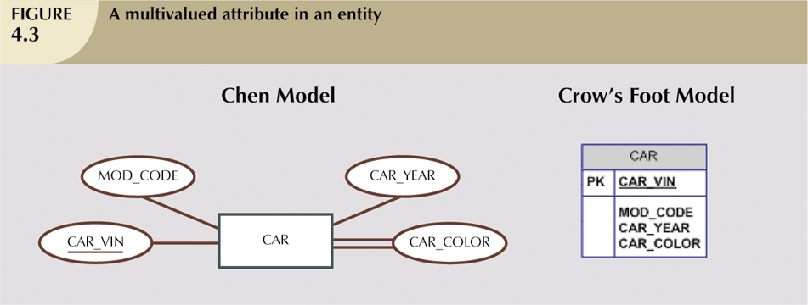
Multivalued Attributes (continued)

Slide 18
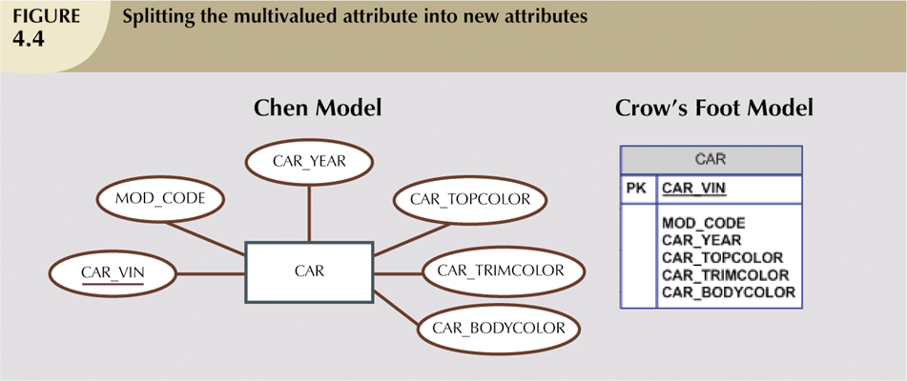
Resolving Multivalued Attribute Problems (continued)

Slide 19
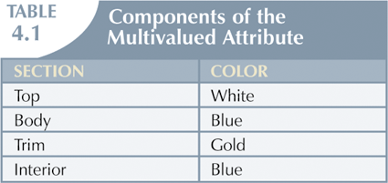
Resolving Multivalued Attribute Problems (continued)

Slide 20
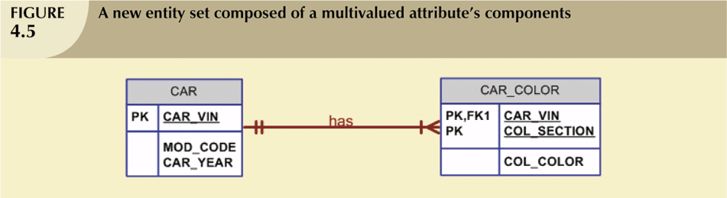
Resolving Multivalued Attribute Problems (continued)

Slide 21
Derived Attributes
Attribute whose value may be calculated (derived) from other attributes
Need not be physically stored within database
Can be derived by using an algorithm

Slide 22
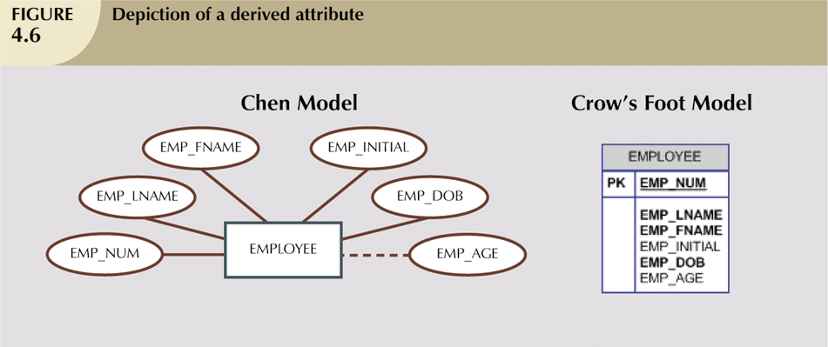
Derived Attributes (continued)

Slide 23
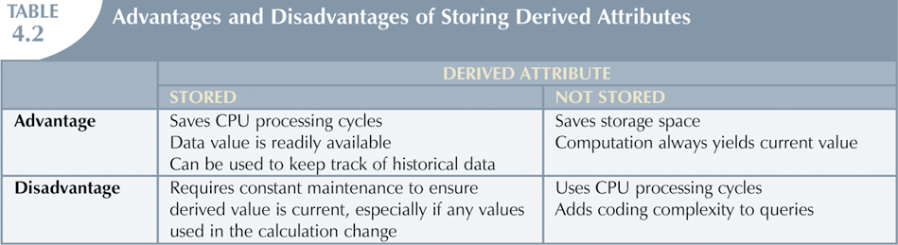
Derived Attributes (continued)

Slide 24
Relationships
Association between entities
Participants are entities that participate in a relationship
Relationships between entities always operate in both directions
Relationship can be classified as 1:M
Relationship classification is difficult to establish if know only one side of the relationship

Slide 25
Connectivity and Cardinality
Connectivity
Used to describe the relationship classification
Cardinality
Expresses minimum and maximum number of entity occurrences associated with one occurrence of related entity
Established by very concise statements known as business rules

Slide 26
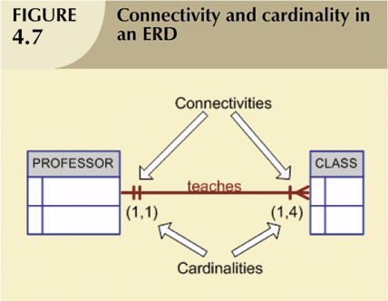
Connectivity and Cardinality (continued)

Slide 27
Weak Entities
Weak entity meets two conditions
Existence-dependent
Cannot exist without entity with which it has a relationship
Has primary key that is partially or totally derived from parent entity in relationship
Database designer usually determines whether an entity can be described as weak based on business rules

Slide 28
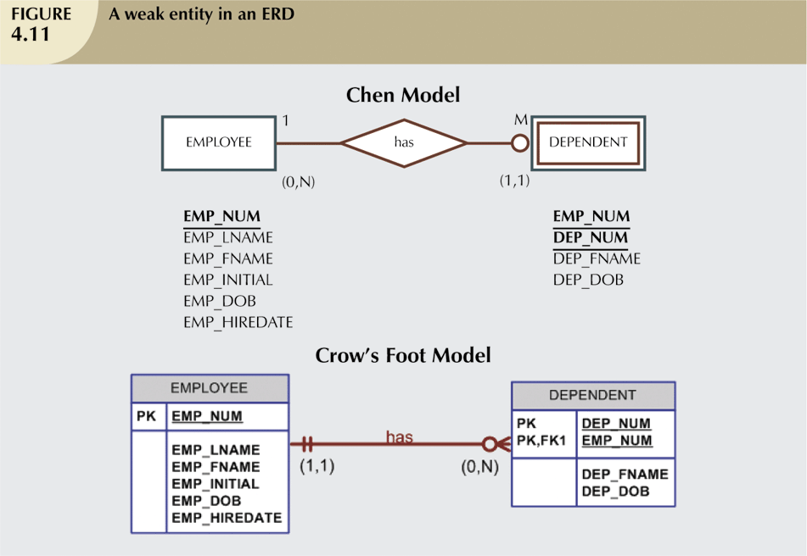
Weak Entities (continued)

Slide 29
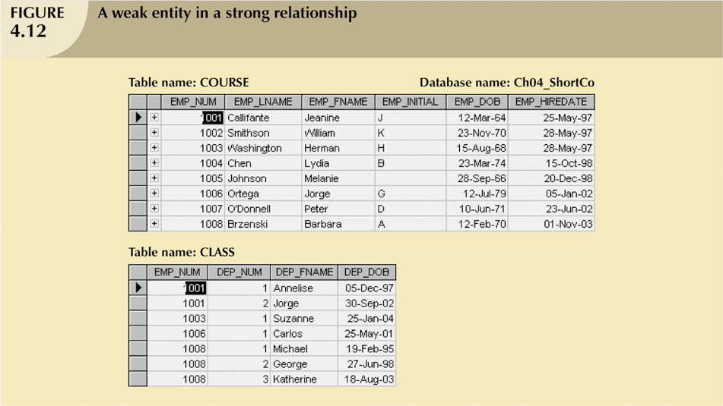
Weak Entities (continued)

Slide 30
Quick Review Question

Slide 31
Summary of Main Teaching Points
Provide 1 example of derived attribute
Provide 1 example of weak entity
Provide 1 example of single-value attribute
Provide 1 example of multi-value attribute

Slide 32
Question and Answer Session
Q & A

Slide 33
What we will cover next
ERD notation
Relationship Participation
Relationship Degree
Composite Entities

